Slide 1
Quantum music
Deeper understanding of connections beetwen science and music

Slide 2
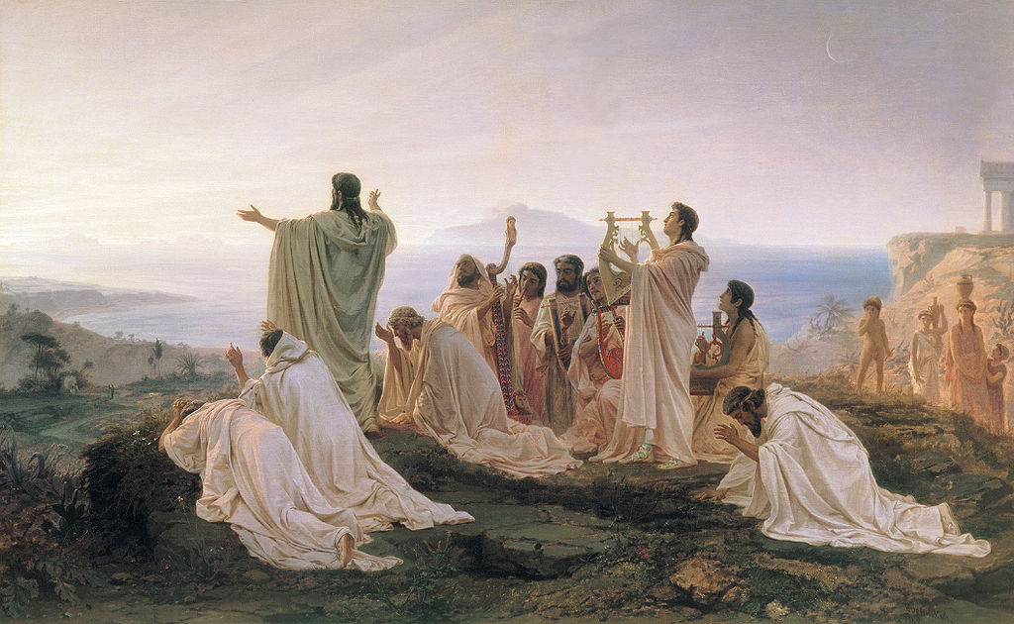
Pythagora (500 B.c.)
Mathematics
Divinity
Music as an intermediary between mathematics and divinity

Slide 3
Decartes (1596 - 1650)
Musicae Compendium: on music theory and the aesthetics of music
Influence on young Newton

Slide 4
Ptolemy (100 a.d.)
Astronomer – Star Catalogue
Influental work: Harmonics
Music first, than math
Tethracords, Octaves

Slide 5
Newton (1642 – 1726)
Physical laws of nature
Motion of planets
Physical force is behind any motion
Force on string – wave motion
Math equations decribes physic laws
After Newton it becomes possible to explain and predict any kind of (wave) motion
Acoustics

Slide 6
Standing waves
First observed by Michael Faraday
Term „standing wave“: Franz Melde (around 1860)
Harmonic series (a.k.a. Fourier series)
Notice: frequencies are quantized, there can be only those that corenspond to the lenghth of the string !

Slide 7
String wave motion

Slide 8
Musical acoustics
Standing wave patterns in giutar body
Wave equations can describe any kind of wave motion

Slide 9
Room acoustics – same principle

Slide 10
The end of physics
Scientists of that time were assure that they can explain anything
„Give me the current state of everything, I will tell you whole future of the Universe“

Slide 11
conclusion: all we have to do is just to play and listen good music

Slide 12
Houston, we have a problem!

Slide 13
Bohr planetary atomic model (1913)
The electron is quantized: it can only exist at specific, descrete orbits/energies
It can absorb or emit only descrete amaunt of energy E = hf that can be observed as descrete line in light spectrum
Every atom has its own spectrum, emission lines “fingerprint“

Slide 15
De Broglie atomic model (1925): electron as a standing wave

Slide 16
Wave/particle duality

Slide 17
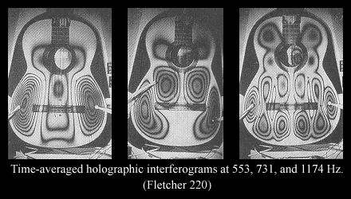
SchrÖedinger wave equation
If we can describe electron as a wave, we can write its wave equation
Picture on the left: solution of such equation for hydrogen atom

Slide 18
Quantum physics
Completely hidden from human beings
World of quantum particles – completely strange
No logical explanation for particles behaviour
Duality
Observation
Entaglement
Set of laws that can not be applied to our reality
Without obvious and measurable connection with acoustics at all, until 1996

Slide 19
Quantum acoustics: Bose-einstein condensate

Slide 20
Quantum acoustics - phonons
Lasers hits BEC, BEC response by vibrating – emmiting PHONONS
PHONON – quant of mechanical vibration
It is possible to measure those vibrations and translate it to audible frequencies

Slide 21
Quantum music project
It is possible to modulate lasers with any audio signal, in order to excite BEC
How will quantum system react to „music excitation“
Playing music with atoms

Slide 22
BEC flute formula – shifted harmony
fo = 50Hz
Musical instruments harmonic series - always adding fundamental
50, 100, 150, 200, 250, 300, 350...
$$f\left(n\right)=\sqrt{n∗\left(n+1\right)}∗fo$$
Harmonic series (Hz): 50, 72, 122, 172, 222, 272, 322, 372, 422, 472...

Slide 23
BEC sphere formula - acoustic beats
$f\left(n,m\right)=\sqrt{{2n}^{2}+2nm+3n+m}∗fo$

Slide 24
Quantum music - technology
Custom design piano interface
Custom made software synthesizers
Development of original electronic musical instrument based on laws of quantum physics

Slide 25
Quantum music
Several layers of approaching the music:
Music inspired by quantum physics
Direct ilustrations of quantum physics principles
Explicite use of sounds from quantum experiments for music composing
Direct connections with quantum systems, „playing“ music with atoms

Slide 26
Thank you! Any questions?
Quantum Music project is completely open for anybody willing to participate
Use of QM instruments ad plug-ins for electronic music production
If you find it interested, please feel free to contact me at any time
dragannovkovic72@gmail.com

